Slide 1
Open House Night with
Cathy Doxtater
My very LAST Open House!!

Slide 2
Info about me
42nd Year of Teaching
10th year at WHS (2000 – 2002, 2017 – present)
Lee HS (1 yr), HSPVA (9 yrs), Episcopal HS (4 yrs), Lamar HS (3 yrs), Westside HS (2 yrs), HC (5 yrs), CMU (2 yrs), HC (8 yrs), WHS (8 yr)
Master in Liberal Arts (MLA, Houston Baptist University – 1990)
Master in Mathematics (MA, Central Michigan University – 2010)
29 years married to husband this December
No children, 2 dogs, 2 cats (long story!), Astros STH, Star Trek Fan

Slide 3
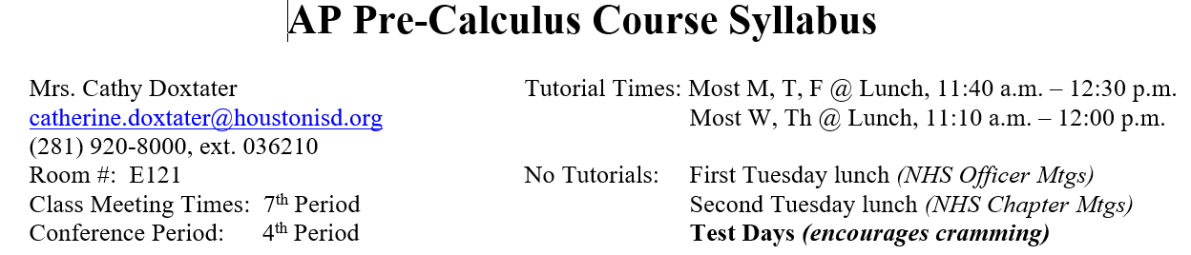
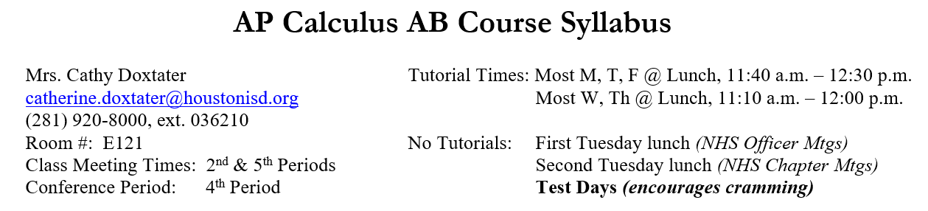
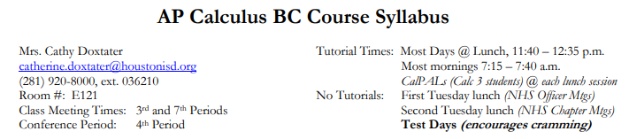
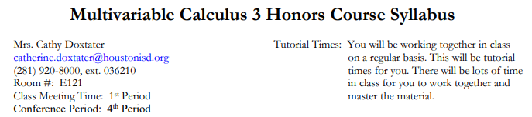
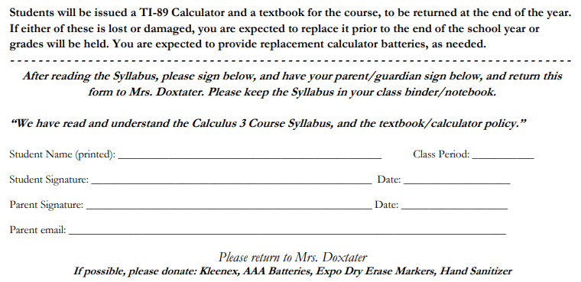
You Signed This Info…

Slide 4
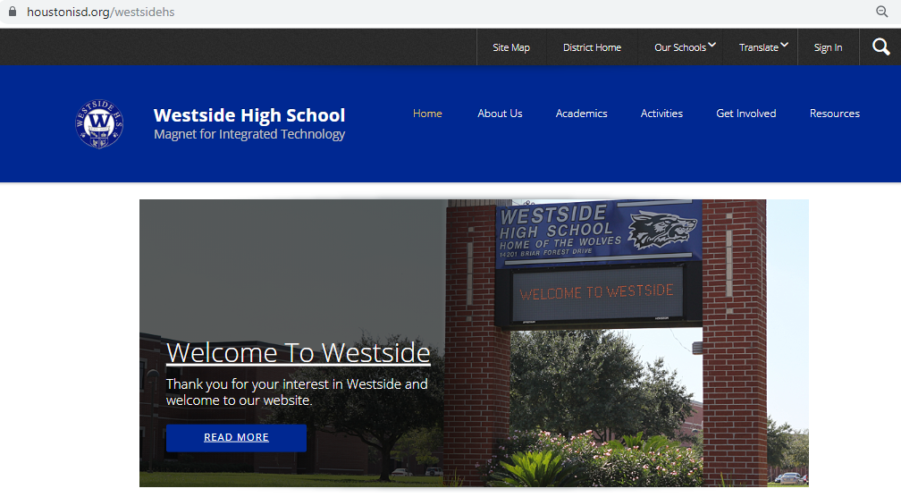
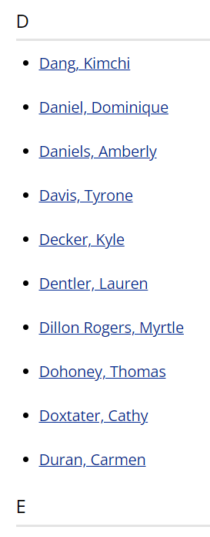
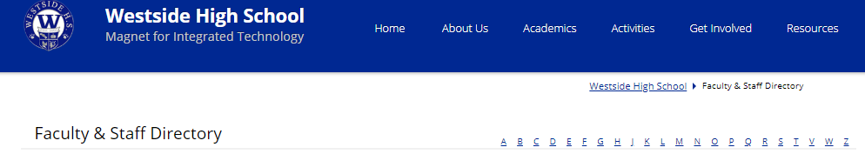
Where to Find Course Info

Slide 5
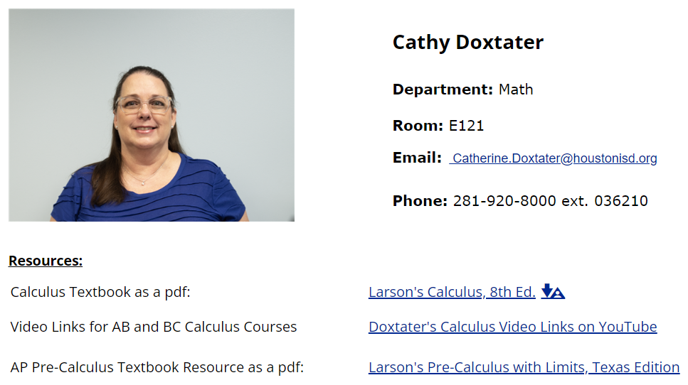
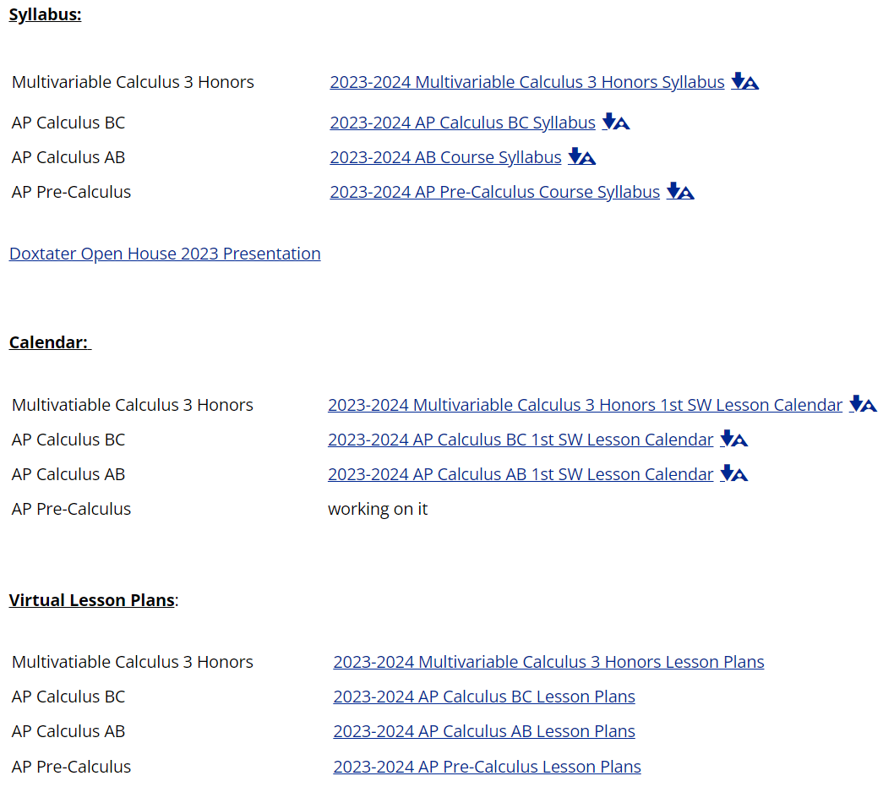
Where to Find Course Info

Slide 6
What I Teach and When
Multivariable Calc 3 Honors – 1st
AP Calculus AB – 2nd
AP Calculus BC – 3rd
AP Pre-Calculus – 4th

Slide 7
Tutorial Access
Available:
Some mornings (7:20 – 7:40)
Some Lunch periods (by appt)
NOT Available:
1st Tuesday of Month Lunch (NHS Officer Mtg)
2nd Tuesday of Month Lunch (NHS Meetings)
Test Days (encourages last-minute studying)

Slide 8
How to Contact Me
catherine.doxtater@houstonisd.org
281-920-8000, ext. 036210
Email is best, and I try to get back to you within 24 hours. Please know that I will rarely answer email during the day because I am focused on the lessons and classes for that day. Also, as this is a college-level course, I will expect to have already had a conversation regarding any concerns with your young adult before engaging in parent intervention. Your young adult must learn the skill of self-advocacy prior to going to college.

Slide 9
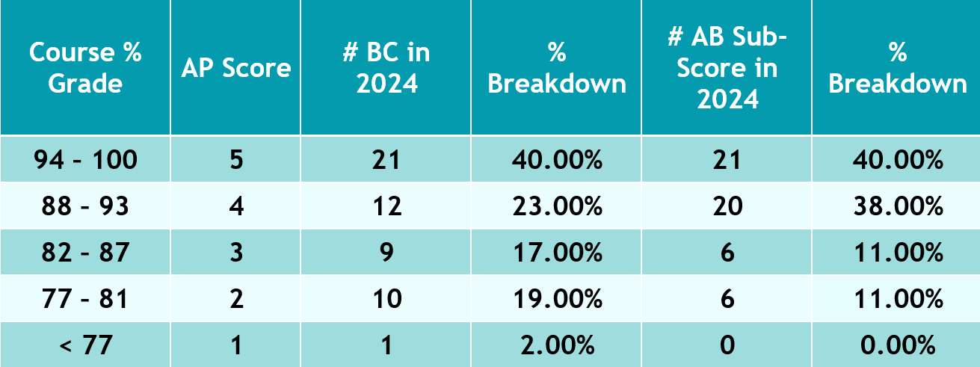
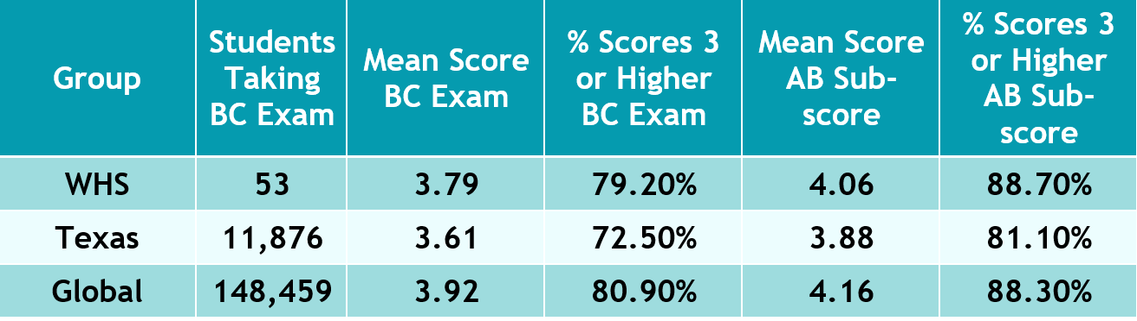
BC Score Breakdown
2024 WHS
BC Scores
42 of 53
79.2% Passing
2024 WHS
AB Sub-Scores
47 of 53
88.7% Passing
2024 WHS
BC Scores
compared
with
state and
global
performance

Slide 10
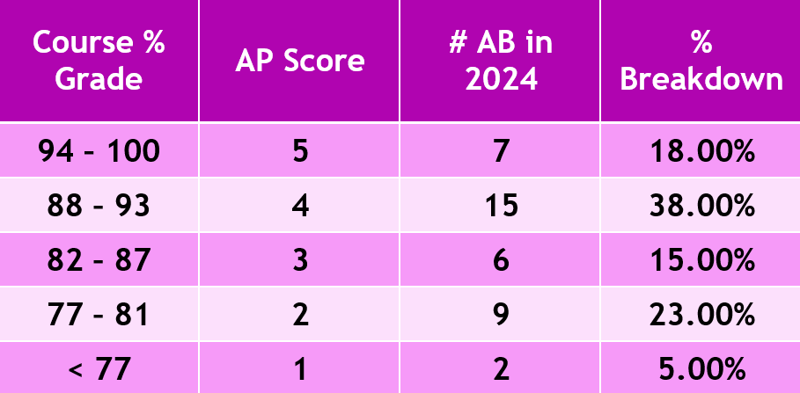
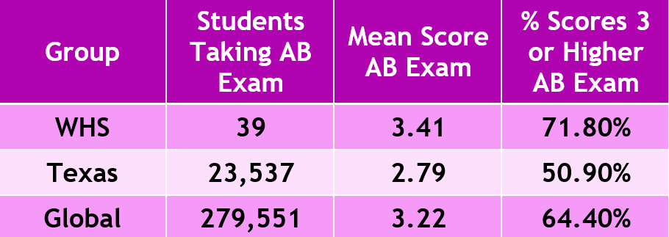
AB Score Breakdown
2024 WHS
AB Scores
28 of 39
77.0% Passing
2024 WHS
AB Scores
compared
with
state and
global
performance

Slide 11
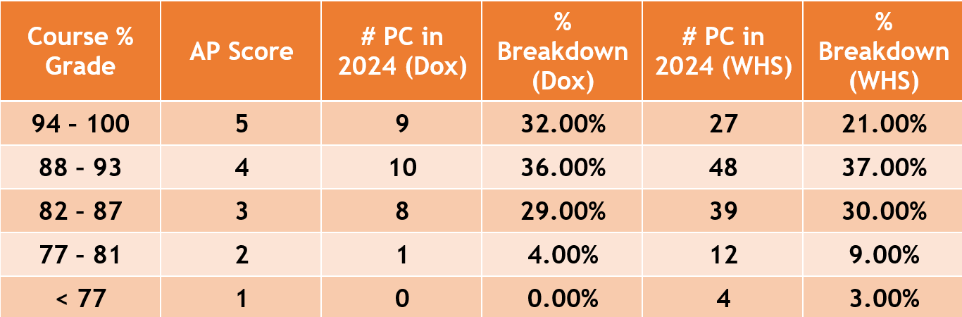
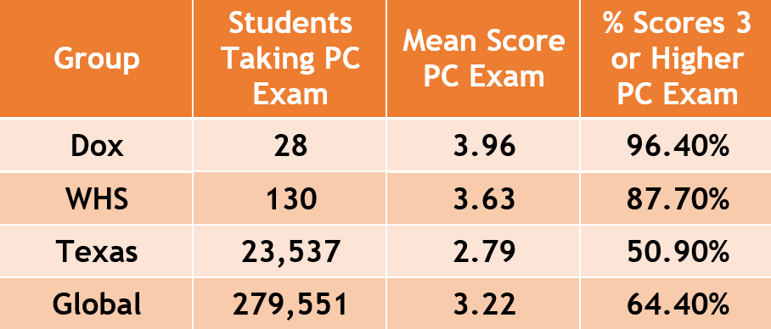
PC Score Breakdown
2024 WHS
PC Scores
Dox: 27 of 28
96.4% Passing
WHS: 114 of 130
87.7% Passing
2024 WHS
PC Scores
compared
with
state and
global
performance

Slide 12
Class Activities
Discuss “Homework” (LOpps – Learning Opportunities and TPs – Try-It Problems)
  Usually students are the ones at the board
  If they can’t explain how they thought through the problem, they probably didn’t do it themselves...and this is a BIG deal!
  Tutors usually don’t have the patience to let the student struggle with thinking through a problem – they are too quick to “coach” – this hurts the student
Calculus: Lesson Notes (Lecture Manual) & Try-It Problems (TPs)
    Sink-in-Problems & Activities in Class (SIPs)
Pre-Calculus: Lesson Notes & Lopps (Unit Worksheets)
Learning Opportunities (LOpps)

Slide 13
Email from Former Student…
Dear Ms. Doxtater,
Thank you so much for being my calculus teacher this past school year. I learned today that I got a 5 on my AP calculus test, and I am really proud of that score. I went into the school year worried that I wouldn't be able to handle the class and believing that I wasn't good at math. Looking back now, I can't believe how far I have come. I couldn't have done it without you. You are probably the best math teacher I have ever had. Whenever I had trouble, either you or a Cal PAL were always there, helping me through the problem. I can honestly say that I have never had a teacher with so much dedication to their job and care for their students… I. S., Class of 2023

Slide 14
Text from Former Student…
Hey Mrs. Dox! How’s the school year been going so far? I just wanted to reach out to thank you again for being such a formative teacher. I’m taking Differential Equations with Linear Algebra as well as Discrete Math right now, and the rigor/foundation you gave us have made the classes so much easier.
O.P., Class of 2023

Slide 15
Active vs. Passive Learning
When students take “ownership” of their learning, they become more confident as they approach difficult concepts (this takes time).
Students are less concerned about getting things wrong, and are more focused on thinking through the main ideas of a problem from a more advanced perspective (confidence increases).
Students learn how to try a variety of methods to analyze and solve problems (critical thinking).
Students become less dependent on the teacher (necessary for college).

Slide 16
How to be Successful…
Be present in class – both physically and mentally.
LOpps (a.k.a. Homework) MUST be completed prior to class, not because there may be a grade attached, but because it takes time for the brain to wrap itself around new topics.
LOpps get the brain actively engaged.
LOpps prepare the student for the next layer of information; when it has not been done, or valiantly attempted, the brain does not have the necessary foundation for the next topic.
The completion of Lesson Videos, Lecture Notes and TPs are essential preparation for the next class meeting. These are the foundation for the next lesson explored more fully in class.

Slide 17
How Can You Support?
Help Promote a “Growth Mindset” with regard to Mathematical Ability.
Avoid language that suggests our abilities in mathematics are fixed.
Avoid language comparing students to other students.
Avoid language that praises a student’s “intelligence.”
Affirm struggle as a part of the learning process.
Applaud strong effort and improvement.
Engage in mathematical conversations with your young adult.

Slide 18
As this session comes to an end…
Please make sure you have completed an index card for me.
If you have questions, please contact me.
Please know that I am so privileged to get to teach your young adults. Thank you for entrusting them to me this year.
Your young adults must be getting to that place of independence as they move toward college-age, so let’s work together to challenge them be self-reliant and responsible for what they need to do.

Slide 19
One Last Thing……
We are in this together and, with respect to your young adults, we have the same goals….
…to love them, to prepare them for life, to help them succeed, and to help them grow.
We don’t grow when we are comfortable, but when we are UNcomfortable!
Never give up!!

